Slide 1
Hot Off the Press: 2013 Ranking Factors
Matthew Peters, Ph.D.
Data Scientist, Moz

Slide 2
How does a search engine work?
On Page signals: 8.4
PageRank: 7.8
Anchor text: 5.9
Social signals: 3.8
etc …

Slide 3
How does a search engine work?
On Page signals: 8.4
PageRank: 7.8
Anchor text: 5.9
Social signals: 3.8
etc …
Search quality raters

Slide 4
How does a search engine work?
On Page signals: 8.4
PageRank: 7.8
Anchor text: 5.9
Social signals: 3.8
etc …
The
Algorithm
Search quality raters

Slide 5
How does a search engine work?
On Page signals: 8.4
PageRank: 7.8
Anchor text: 5.9
Social signals: 3.8
etc …
The
Algorithm
Search quality raters

Slide 6
Different feature types include: On-page, links, anchor text, social signals and properties of the URL

Slide 7
URL
www.mrqe.com
Different feature types include: On-page, links, anchor text, social signals and properties of the URL

Slide 8
On-page
URL
www.mrqe.com
Different feature types include: On-page, links, anchor text, social signals and properties of the URL

Slide 9
On-page
Links
URL
www.mrqe.com
Different feature types include: On-page, links, anchor text, social signals and properties of the URL

Slide 10
On-page
Links
URL
www.mrqe.com
“movie reviews”
Anchor Text
Different feature types include: On-page, links, anchor text, social signals and properties of the URL

Slide 11
On-page
Links
URL
www.mrqe.com
“movie reviews”
Social
Anchor Text
Different feature types include: On-page, links, anchor text, social signals and properties of the URL

Slide 12
Which factors are important?

Slide 13
Which factors are important?
What Google says

Slide 14
Which factors are important?
What’s in the algorithm
What Google says

Slide 15
Which factors are important?
What’s in the algorithm
What Google says
What SEOs say

Slide 16
Which factors are important?
What’s in the algorithm
What Google says
Characteristics of sites that rank well
What SEOs say

Slide 17
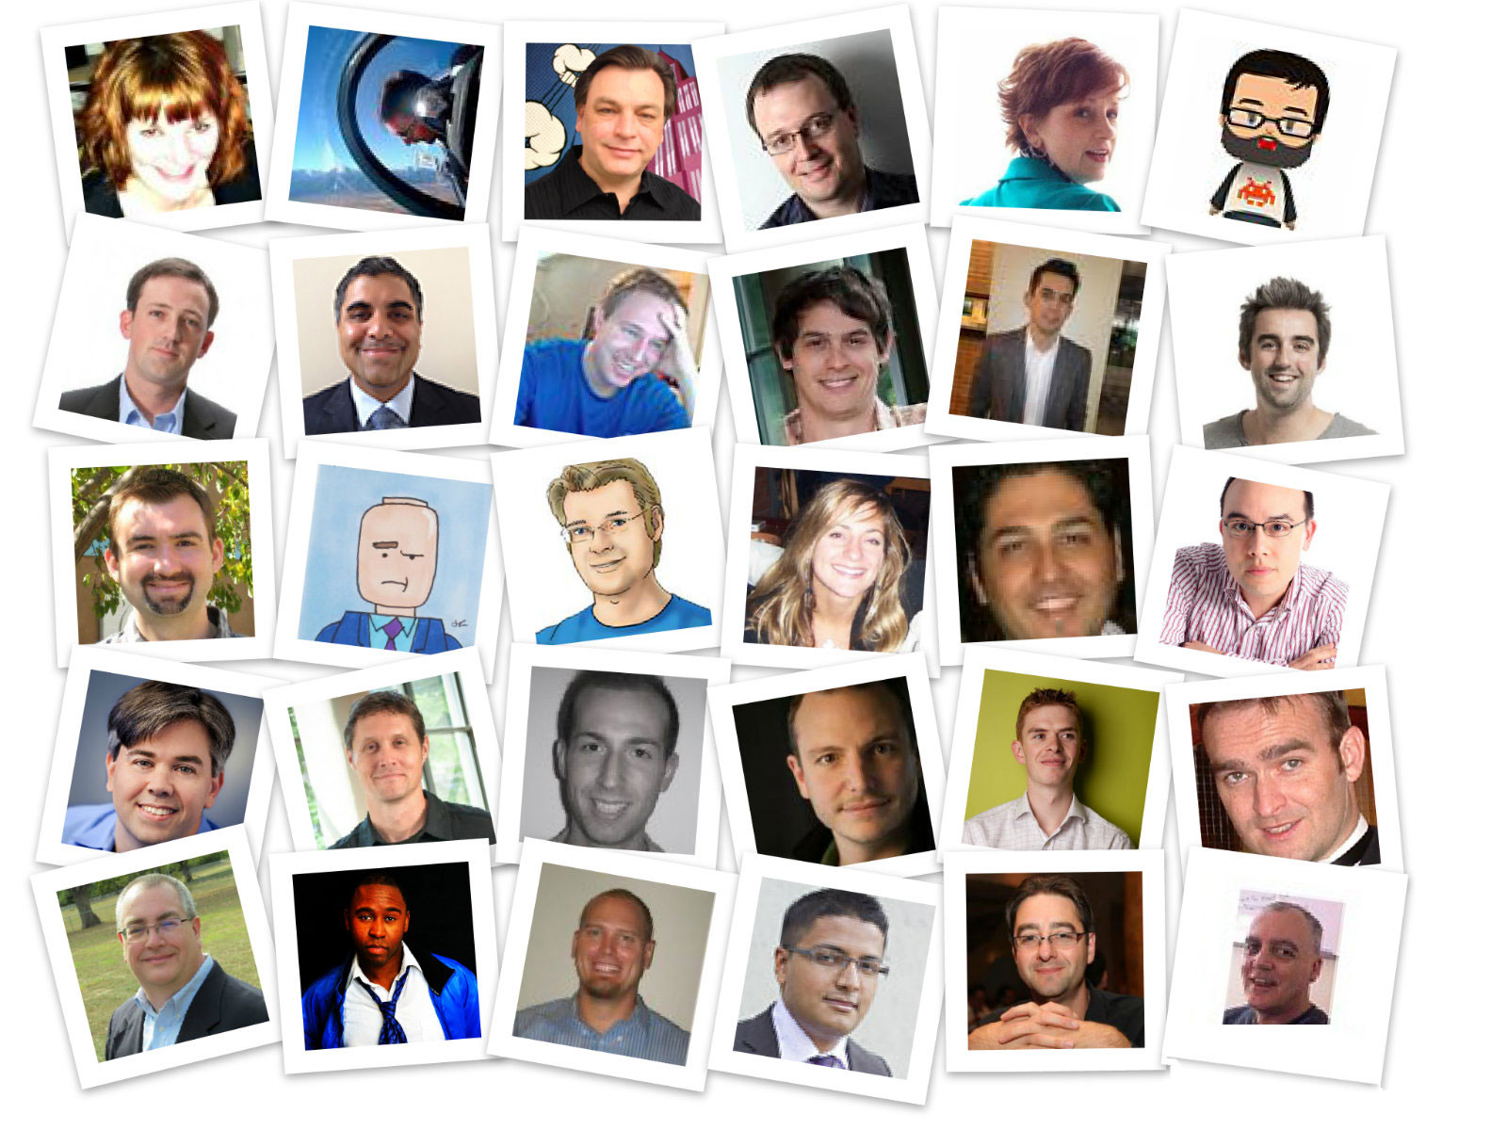
Survey
120 professional SEOs surveyed in mid-June 2013
Thanks to everyone who participated and Cyrus Shepard and Matt Brown for organizing

Slide 18
Survey

Slide 19
Survey

Slide 20
Survey
Respondents rated each factor from 1-10 on their importance in ranking.
Use average importance rating.
Highest rated factors scored 7-8, lower rated factors scored 3-5.

Slide 21
Correlations
14,000+ keywords from Google Adwords
All categories and search volumes included
Top 50 results from Google US
De-personalized, de-localized organic results
First week of June 2013

Slide 22
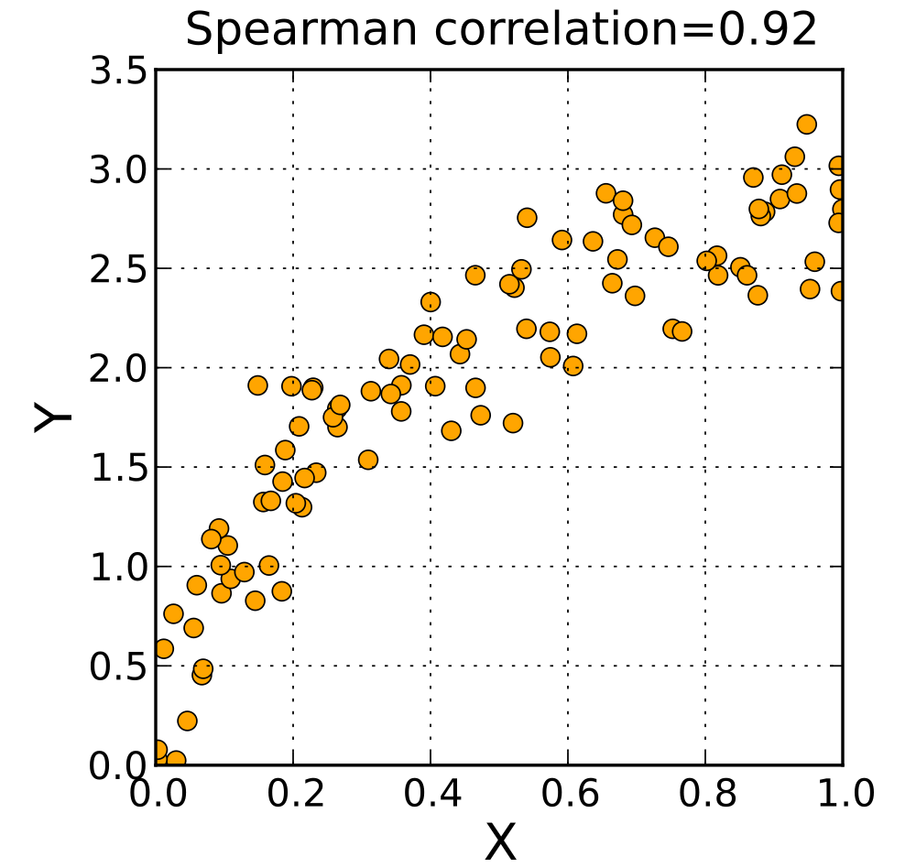
Correlations
Mean Spearman Correlation
Compute for each keyword, then average
Measures extent to which increases in one factor are related to rank
Correlations between -1 and 1. Values of 0.1 - 0.3 are common.
Thanks to Jerry Feng and Mike O’Leary for extracting features!

Slide 23
"Correlation is not causation but it sure is a hint" - Edward Tufte
Correlation and causation
Links
??
Higher rank

Slide 24
"Correlation is not causation but it sure is a hint" - Edward Tufte
Correlation and causation
Links
Higher rank

Slide 25
"Correlation is not causation but it sure is a hint" - Edward Tufte
Correlation and causation
Correlation, but causation?
Links
More words on page
??
Higher rank
Higher rank

Slide 26
"Correlation is not causation but it sure is a hint" - Edward Tufte
Correlation and causation
Correlation, but causation?
Links
More words on page
Higher quality
??
Higher rank
Higher rank

Slide 27
"Correlation is not causation but it sure is a hint" - Edward Tufte
Correlation and causation
Correlation, but causation?
Links
More words on page
Higher quality
??
Links
Higher rank
Higher rank

Slide 28
"Correlation is not causation but it sure is a hint" - Edward Tufte
Correlation and causation
Correlation, but causation?
Links
More words on page
Higher quality
Links
Higher rank
Higher rank

Slide 29
Links

Slide 30
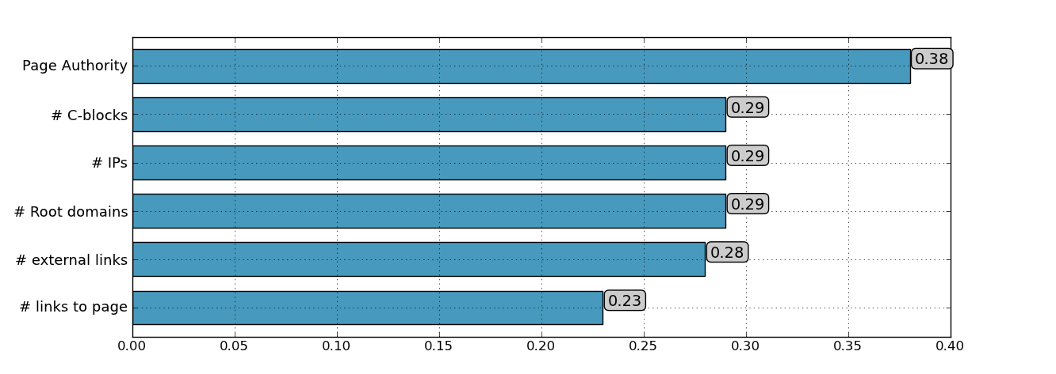
Correlations: Page level links
Link diversity still very important.
Page Authority highest overall correlated metric.

Slide 31
Page Authority is a machine learning model that predicts ranking based on links.
See: http://moz.com/learn/seo/page-authority

Slide 32
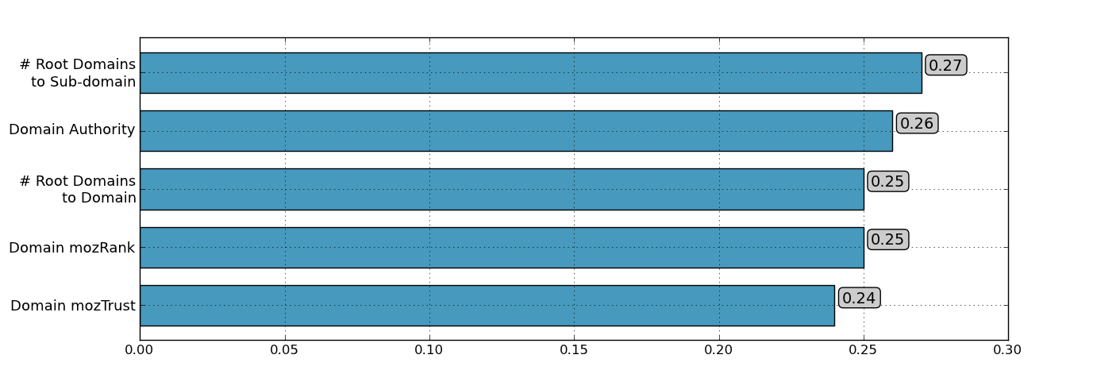
Correlations: Domain level links
Domain in-link correlations generally lower the page links.
Sub-domain metrics now have higher correlation then domain metrics.

Slide 33
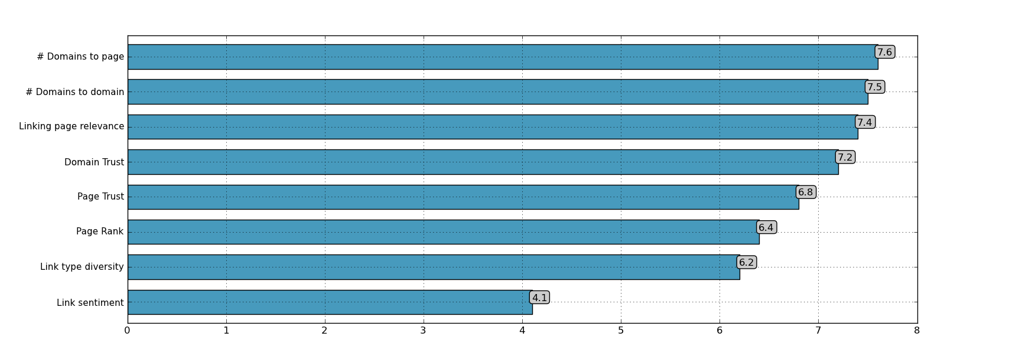
Survey: Links
Consistent with correlations, links from domains most important.
Relevance of page/domain also thought to be very important.

Slide 34
Anchor Text

Slide 35
Correlations: Anchor text
Partial and exact match have same correlation.
Internal anchor text correlations significantly lower then external.

Slide 36
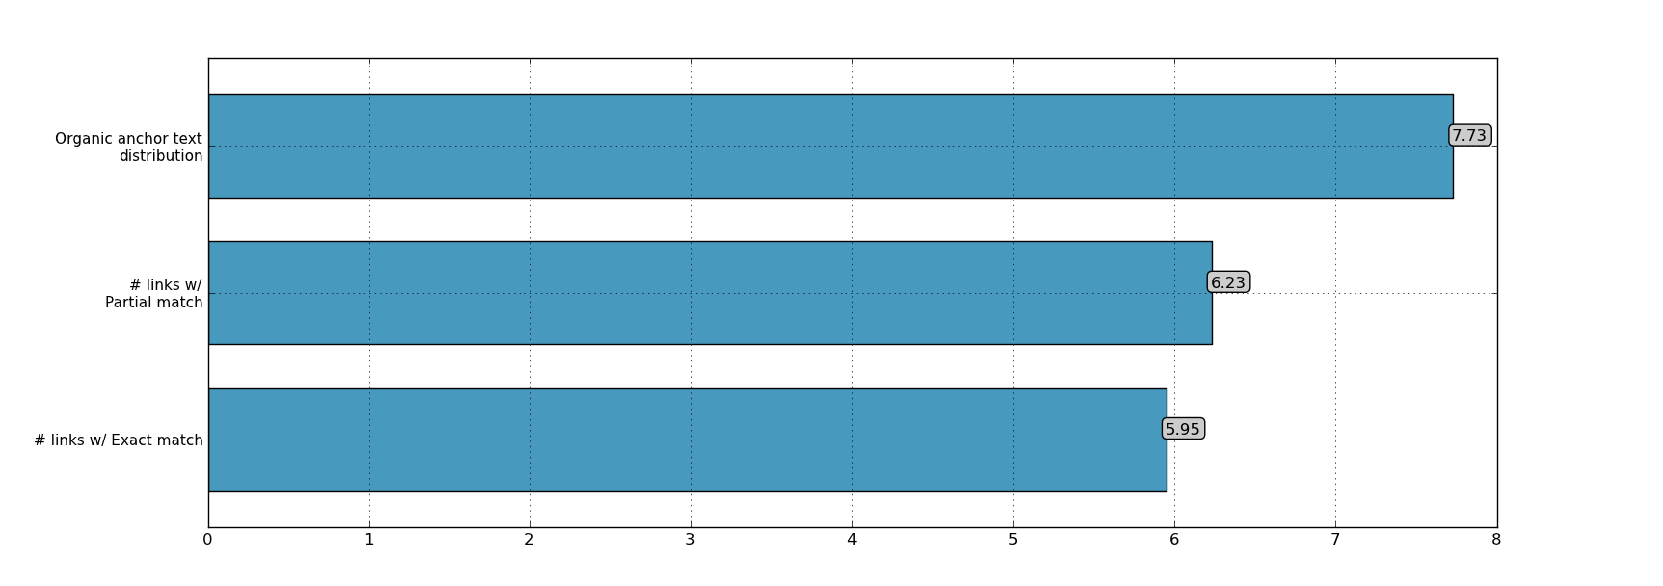
Survey: Anchor text
After Penguin, organic (mix of branded, non-branded) anchor text distribution thought to be more important the quantity.

Slide 37
Site Speed

Slide 38
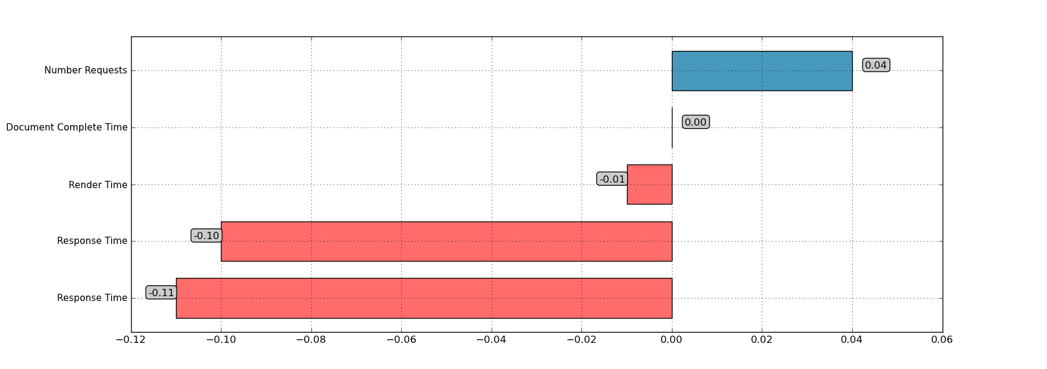
Correlations: Site speed
Zoompf to provided the speed data.
Response time has negative correlation, but total load time does not!

Slide 39
Speed and users
40% of customers will abandon any site that takes longer than 3 seconds to load
Conversion rate drops by 7% for every 1 second of load time
Jonathon Colman:
http://www.slideshare.net/jcolman/seo-site-speed-and-battlestar-galactica-searchfest-2012-11735155

Slide 40
On-Page

Slide 41
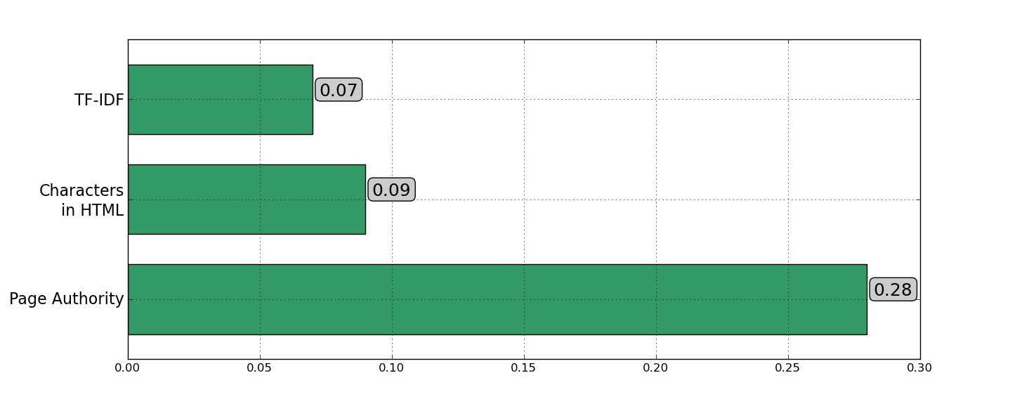
Correlations: Keyword on-page
2011
In 2011, we found low on-page keyword related factors.

Slide 42
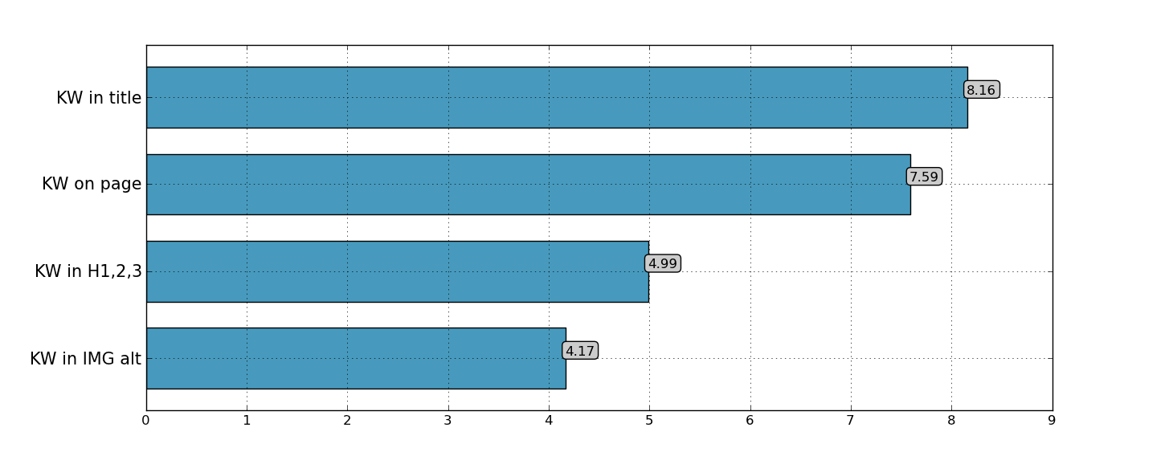
Survey: On-page
2013
General consensus that KW in are important.

Slide 43
Beyond TF-IDF
> 700 papers
See http://moz.com/blog/determining-relevance-how-similarity-is-scored

Slide 44
Beyond TF-IDF
> 700 papers
Language Model
P(optimization | search, engine) >>
P(walking | search, engine)
See http://moz.com/blog/determining-relevance-how-similarity-is-scored

Slide 45
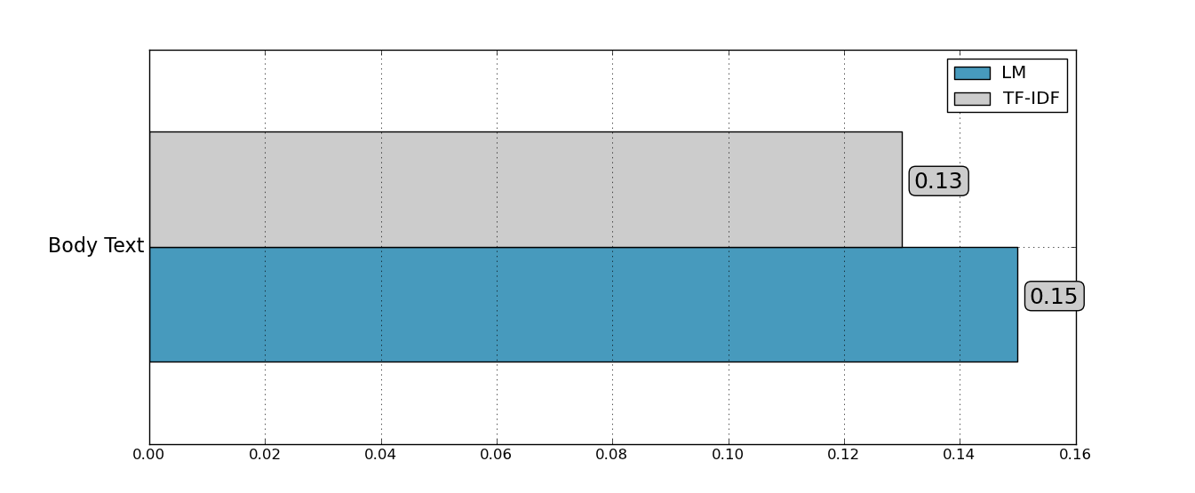
Correlations: Keyword on-page
2013
Using a more sophisticated model increases correlations.
We also used a larger corpus in 2013 that should increase correlations.

Slide 46
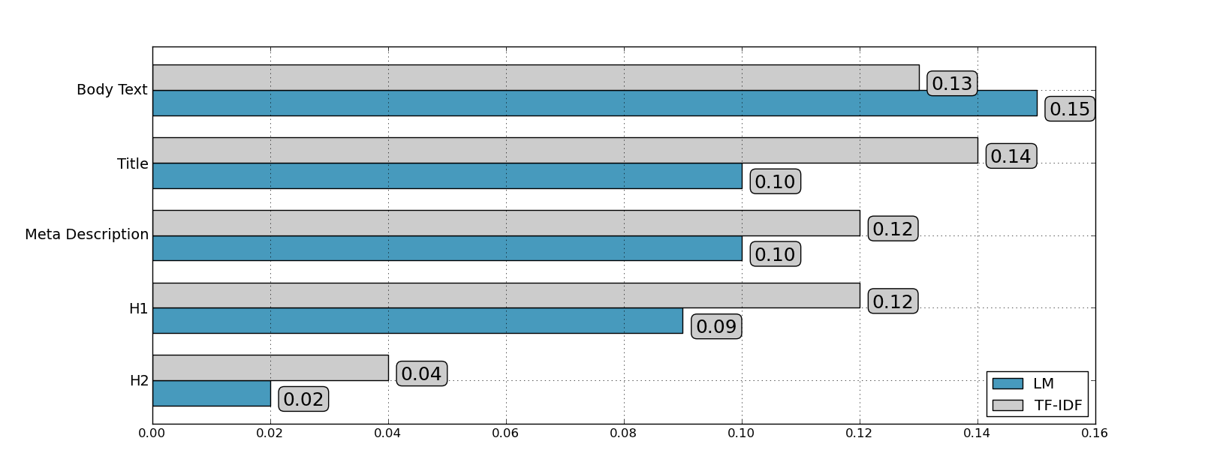
Correlations: Keyword on-page
2013
Title, meta description and H1 all have relatively high correlations.

Slide 47
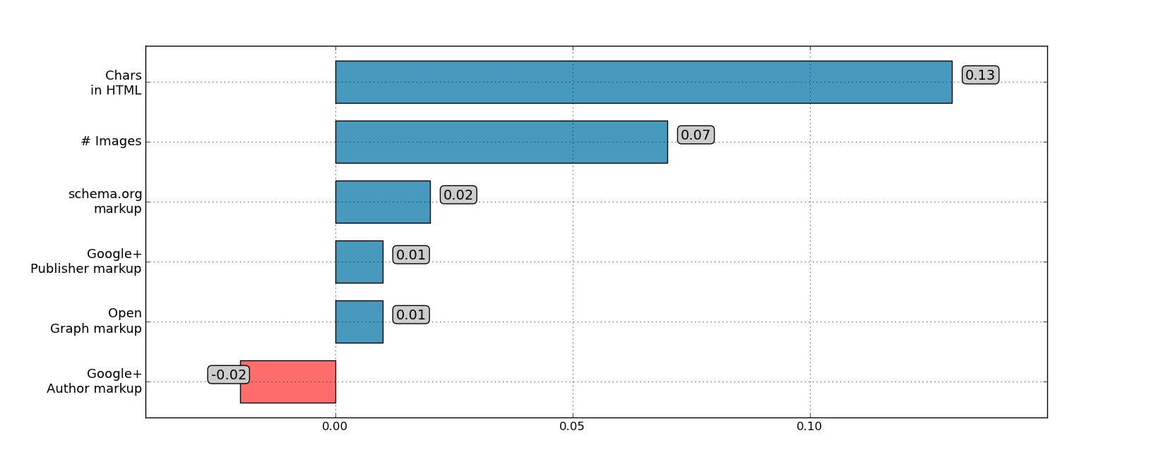
Correlations: Other on-page
Document length has relatively high correlation.
Structured data and Google+ markup has no correlation

Slide 48
Are sites implementing structured data?
Markup | Percent of URLs
Open graph | 36.9%
schema.org | 9.9%
G+ publisher | 7.1%
G+ author | 2.2%

Slide 49
Don’t ignore authorship

Slide 50
URL-Domain

Slide 51
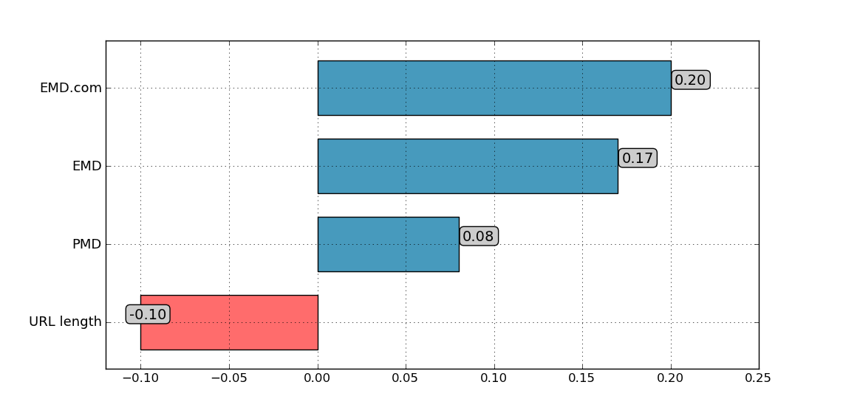
Correlations: URL
Query: “adidas sneakers”
Exact Match Domain (EMD): www.adidassneakers.com
Partial Match Domain (PMD): www.adidas.com

Slide 52
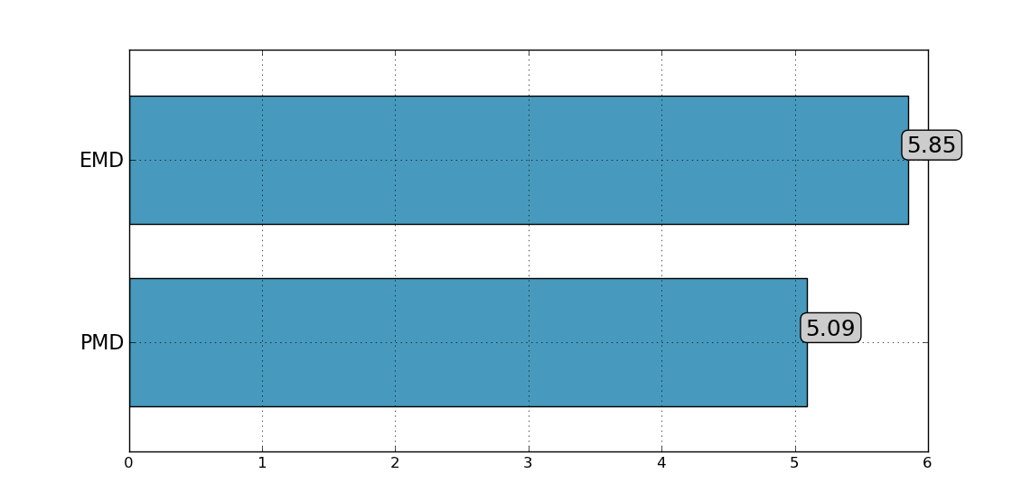
Survey: URL
Query: “adidas sneakers”
Exact Match Domain (EMD): www.adidassneakers.com
Partial Match Domain (PMD): www.adidas.com

Slide 53
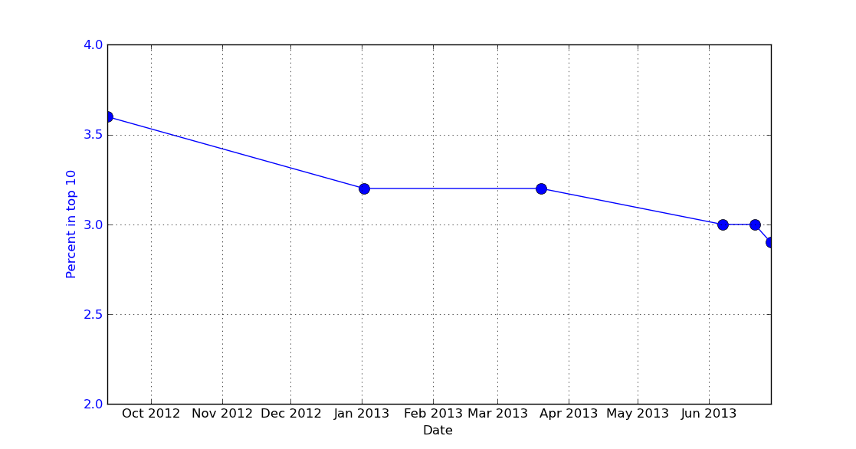
Exact match domain over time

Slide 54
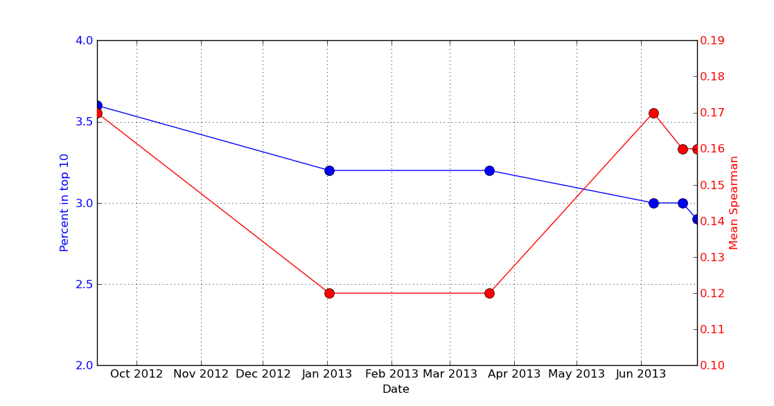
Exact match domain over time

Slide 55
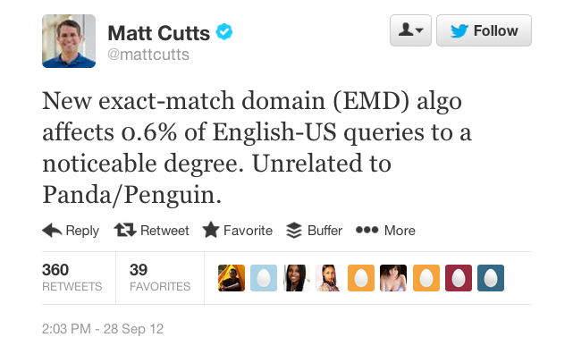
Exact match domain over time

Slide 56
Exact match domain over time

Slide 57
Exact match domain over time
Removal of low quality EMDs??

Slide 58
Brand metrics

Slide 59
Correlations: Brand metrics

Slide 60
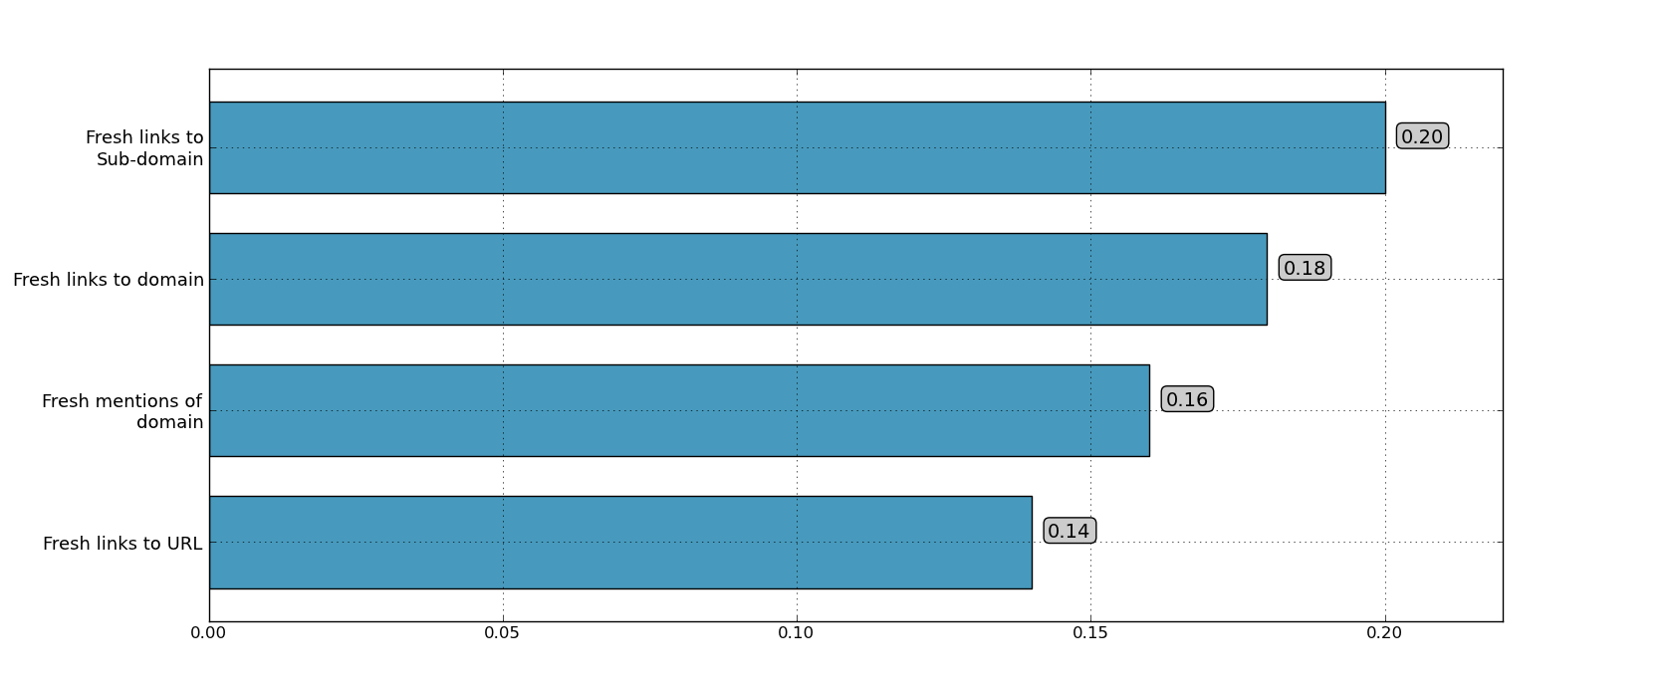
Correlations: Brand metrics
Fresh and brand mentions have a relatively high correlation.

Slide 61
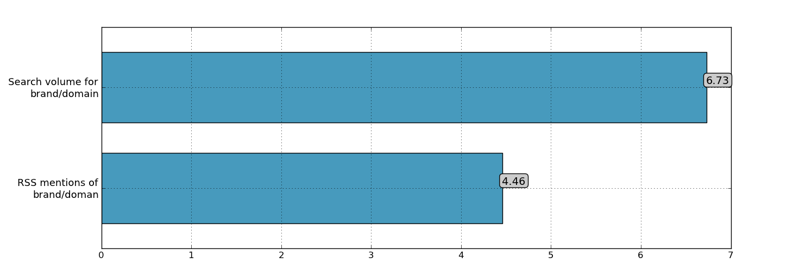
Survey: Brand metrics
Other then search volume, SEOs thought that brand mentions were relatively unimportant.

Slide 62
Social

Slide 63
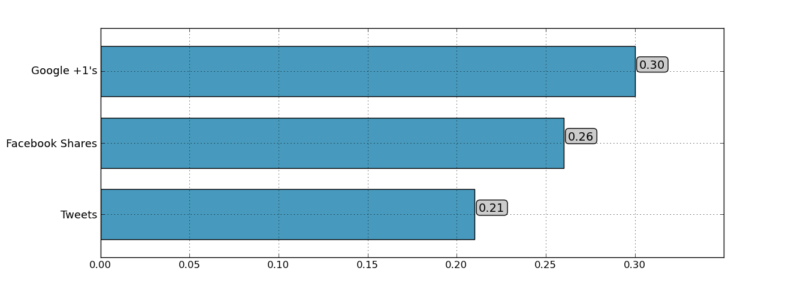
Correlations: Social
Google +1’s second highest correlation metric (behind PA)!

Slide 64
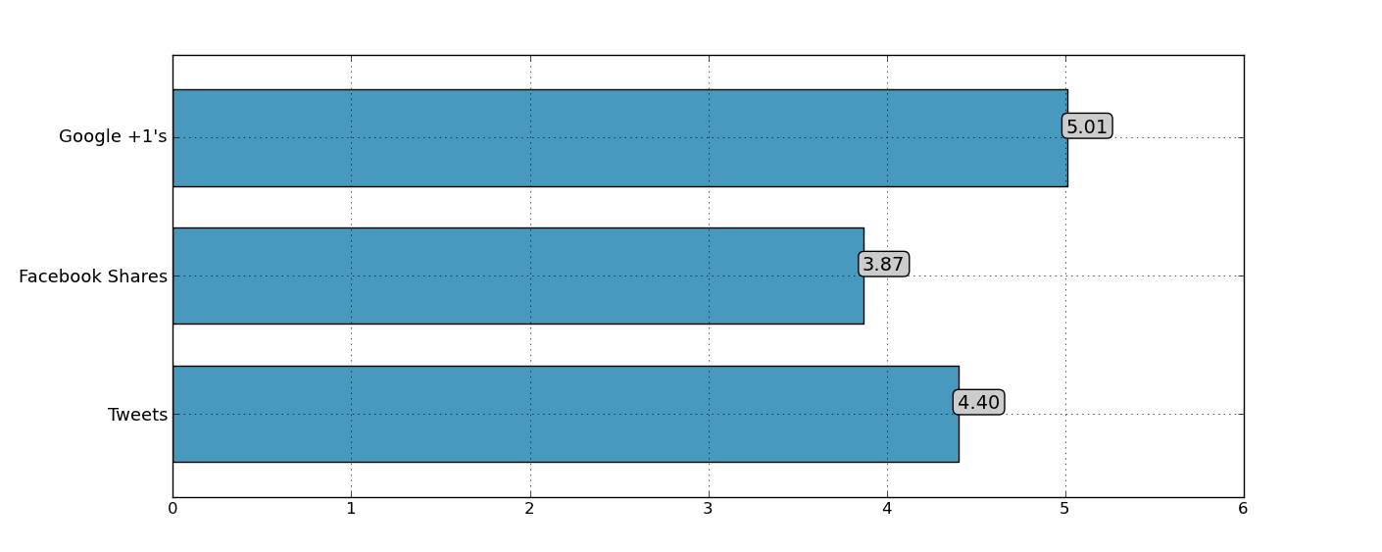
Survey: Social
Overall, SEOs didn’t score social factors as highly as links or keywords.
Google +1’s ranked highest, followed by Tweets, then Facebook shares.

Slide 65
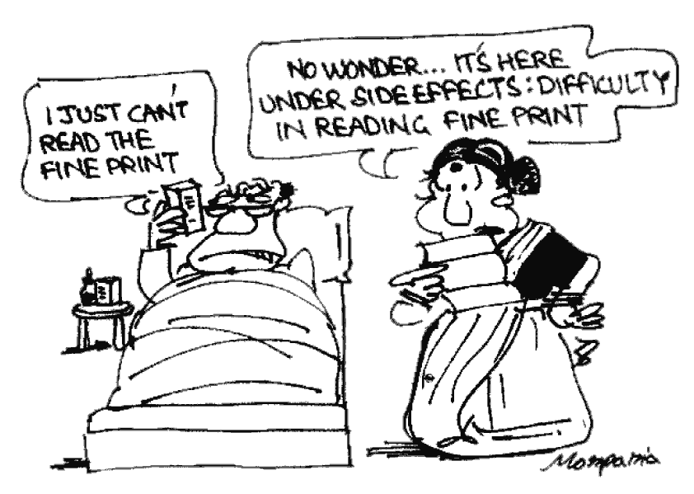
Some words of caution
Methodology matters!

Slide 66
Comparing studies

Slide 67
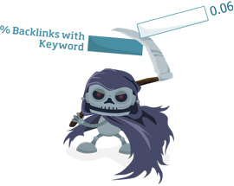
Comparing studies
Our correlation is 0.29 for keyword in anchor text.
Searchmetrics removed navigation queries, but we included them. Does this explain the difference?

Slide 68
Comparing studies
Our correlation is 0.29 for keyword in anchor text.
Searchmetrics removed navigation queries, but we included them. Does this explain the difference?
EMD is their highest correlation at 0.43, except they used rank-biserial correlation.
Using Spearman for EMD gives 0.15 (we have 0.17).

Slide 69
Takeaways

Slide 70
Overall algorithm

Slide 71
Overall algorithm
Links are still very important, both as judged by SEOs and in the data.

Slide 72
Overall algorithm
On page keyword and content features still fundamental.

Slide 73
Overall Algorithm
Despite high correlations, SEOs don’t think social is important.
Correlation vs. Causation?

Slide 74
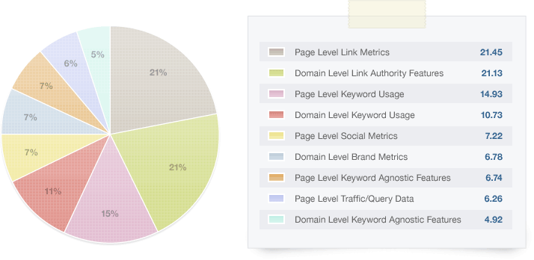
Overall algorithm, 2011 vs 2013
2011
2013
SEOs think EMD/PMDs decreased in importance.
Prevalence decreases but correlations remain same.

Slide 75
Future predictions
Quality, authorship, structured data, social all predicted to increase in importance.

Slide 76
Future predictions
Quality, authorship, structured data, social all predicted to increase in importance.
EMD, paid links, anchor text expected to decrease.

